Slide 1
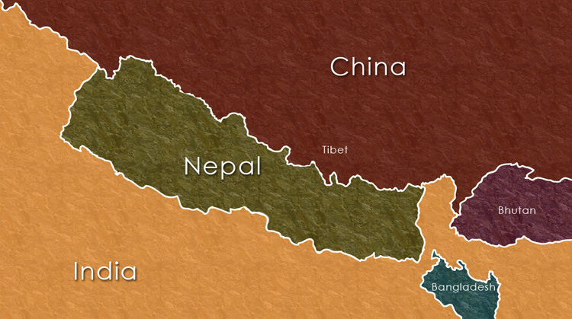
Geography of Nepal
Subject: Nepalese society and Politics
By Professor Dr Devi Bahadur Thapa

Slide 2
Content
Location, size, shape and extent
Boundaries
Physical Features

Slide 3
Location, size, shape and extent
# Location
Landlocked country
Located between 26⁰ 22” North and 30⁰ 27” north latitude and between 80⁰ 4” east and 88⁰ 4” east longitude

Slide 4
# SIZE
Total area is :
1,47,181 km² (sq. km)

Slide 5
# SHAPE
Distorted rectangle

Slide 6
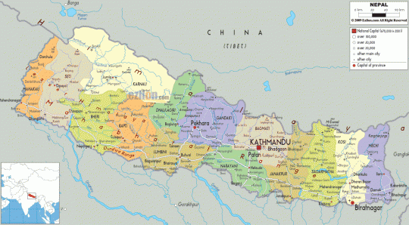

Slide 7
# EXTENT
Length: 885 km in east to west
Breadth : varies from minimum of 145 km to the maximum 241 km (avg = 193 km)

Slide 8
# BOUNDARIES
North
Tibetan territory of China
East
Sikkim and West Bengal state of India
South
UP and Bihar State of India
West
Uttaranchal Pradesh of India

Slide 10
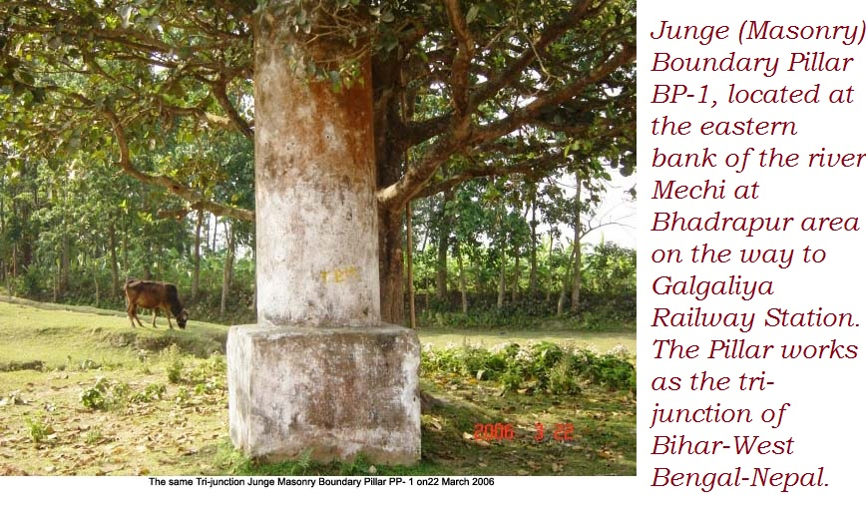
Nepal is separated from these territories by artificial pillars

Slide 11
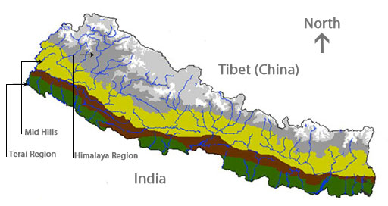

Slide 12
PHYSICAL FEATURES
On the basis of topographic features, Nepal can be divided into 3 physical division
Terai region
Hilly region
Himalaya region

Slide 13
Terai Region
Southern part of Nepal, part of Gangetic plain in north of India, its width is only 25 to 30 km
Area is 17% of total area of Nepal
Division :
Main terai
Inner terai
Bhawar Pradesh

Slide 14
Main terai
Districts included are;
Jhapa
Morang
Saptari
kapilbastu

Slide 15
Inner terai
It is very fertile for agriculture production
It produces the largest amount of food grains
District included are;
Udaypur
Sinduli
Makawanpur
Chitwan
Dang
Deukhuri etc…

Slide 16
Hilly region
It is in between Himalaya and Terai region
Area is 68% of total area of Nepal
It consists of Mahabharat mountain, Churia hills, tar and river basin
Its altitude is from 600 m to 3000 m
The Mahabharat range is from 1500 to 3000 m
Kathmandu valley and Pokhara valley lie in this region
In the southern part of this region Churia hill runs from Koshi river
It is also known as Siwalik range

Slide 17
Himalaya Region
It is northern belt of Nepal
It covers 15% of total area of Nepal
It starts from 3000 m height to 8848 m height
More than 26 Himalaya ranges are there which are
Kumbhakarna
Dhawalagiri
Kanjivowa etc

Slide 18
Mt Everest lies in Mahalangur Himalaya range
Other major peaks are:
Mt Kanchanjanga (8586m 3rd highest peak of world)
Mt Lhotse (8516m)
Mt Makalu (8463m)
Mt Gaurisankar (7134m)
Mt Machhapuhre (6996m)
Mt Choyu (8201m)
Mt Dhaulagiri (8169m)

Slide 19
There are various important passes in between the ranges such as;
Kodari
Rasuwa
Mustang etc

