Slide 1
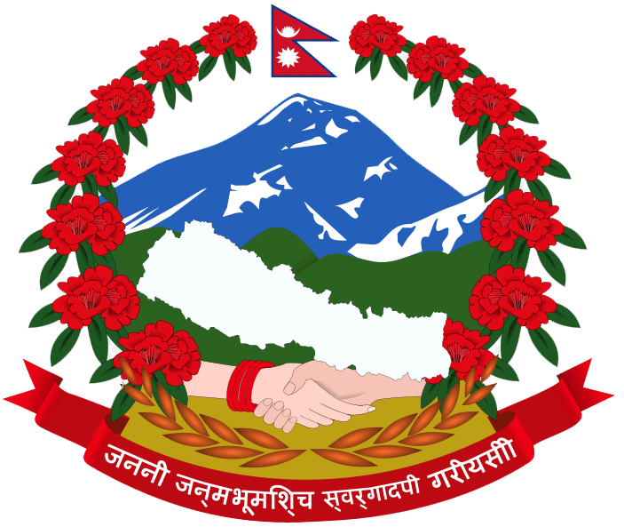
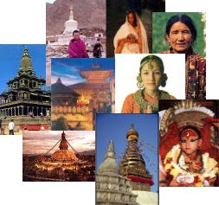
ORIGIN OF NEPAL :
NEPAL AS A SOVEREIGN COUNTRY
sub: Nepali Society and Politics
By Prof. Dr. Devi Bahadur Thapa

Slide 2
Nepal is an independent and sovereign mountainous country situated between China in North and India east west and South
There is 2 aspect of sovereignity
Internal aspect
External aspect
Internally, Nepal has supreme power
Its order should be obeyed by all the people living in the country and no any individual, group, organization and association within the country is above it

Slide 3
Nepal is not bound to follow command of any foreign country and no foreign country can order her
Nepal is free to deal with other foreign country
Nepal has remained sovereign country since ancient time
Nepal is sovereign in past and is still now
She was never colonized by foreign country

Slide 4
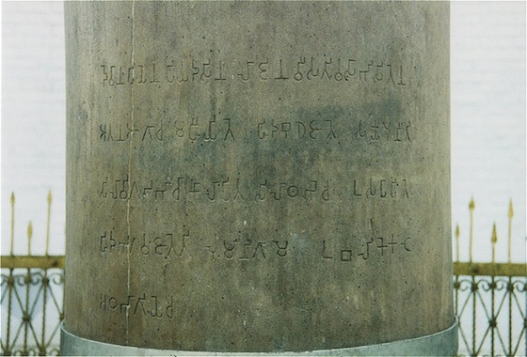
During the timeof 14th Kirati king ‘Sthunko’ , the emperor of Delhi, Ashok came Lumbini and erected pillar (Ashok pillar) in the memory of Buddha. It is the evidence of sovereignty of the then Nepal

Slide 5
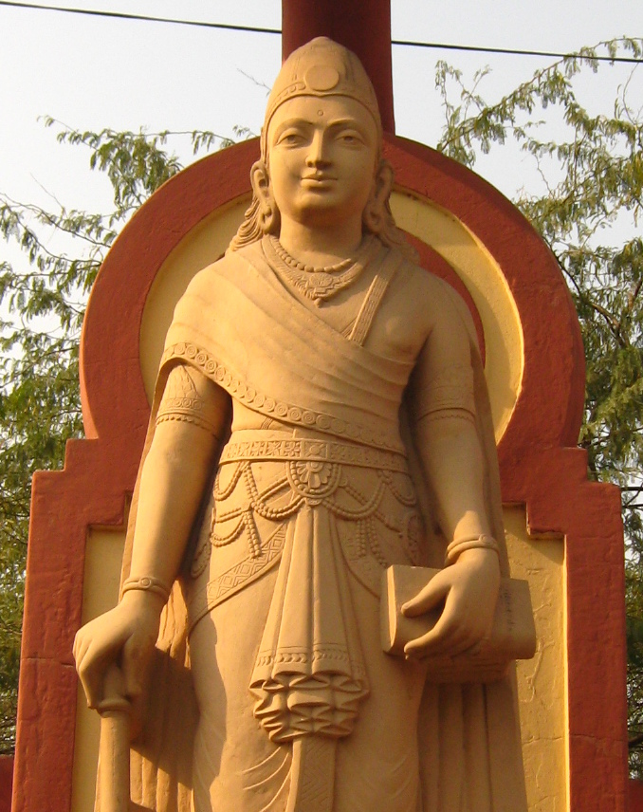
Fig: Chandra gupta
In the earlier time, Brisha Dev (grandfather of Man Dev) was powerful king
Indian emperor Chandra Guptta was jealous of Brisha Dev
To keep the friendly relationship Brisha Dev got marriage his daughter Kumari Devi with Chandra Guptta

Slide 6
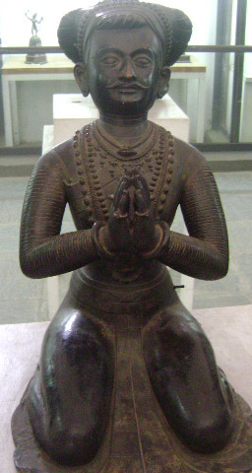
During the period of Amshuvarma, the Indian King Harshabardan and Tibetan King ‘Tsrong Tsang Gampo’ were tried to expand their territories
Amshuverma tried his best to keep friendly relationship to those countries and protected sovereignty of Nepal

Slide 7
During the period of Narendra Dev (700 BS) Nepal’s relation with China, Tibet and India was remained good
Narendra Dev had sent a mission to China with presents and messages of good will
During this time Chinese mission with the leadership of Wang Hiven Tse visited Nepal

Slide 8
In the Medieval period Nepal was divided into several petty states such as Baaise and Chaubise rajyas due to weak centre, The Kathmandu Valley
The valley itself was divided into three states ( Kantipur, Patan and Bhaktapur)
Similarly in Eastern Tarai there were 3 states
Makawanpur
Chaudandi
Vijaypur
These states were established by feudal lords and were not captured by foreign power
They were just only as administrative units

Slide 9
Thus it can be said that Nepal had never remained under the domination of foreign nation

Slide 10
East india company came in India in1600A.D.
In the north China and Tibet was powerful country
Nepal was in between them and both northern and southern countries set their eyes to Nepal
Prithhivi Narayan Shah, King of Gorkha, started unification of Nepal to protect the sovereignty of this land
In course of unification Prithivi Narayan Shah can be considered as the protector of sovereignty of this country
He was always alert to foreign countries

Slide 11
For the protection of territorial sovereignty Nepal had to make a war with its Northern as well as Southern neighbour
  There was war between Nepal and Tibet in 1845 B.S.
  Before Sugauli treaty (1871 B.S.) there was war between Nepal and East India Company government in India

Slide 12
Nepal has been remained as sovereign country
Its sovereignty is in continuity since very beginning of its history
1923 A.D. British government first time gave recognition to it as a sovereign and an independent nation
Nepal got U.N.O membership in 2013 B.S.
Nepal became member of U.N. security council in 2015 B.S.

Slide 13
Nepal is participating from time to time in international forum
She is free to express her views on international issues in the capacity of a sovereign nation
Nepal has maintained its friendly relation with the most countries of the world

Slide 14
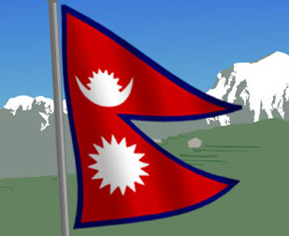
THANK YOU

