Slide 1
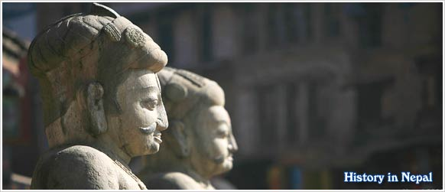
POLITICAL HISTORY OF NEPAL
Subject: Nepalese society and Politics
By Professor Dr Devi Bahadur Thapa

Slide 2
Introduction
Prehistoric period
Gopal dynasty ruled over Kathmandu valley
A/c to Gopal Chronicles(Vamsawali) Bhuktaman was the first ruler
8 Gopal kings ruled over kathmandu valley for about 500 years
Last king of Gopal king was Yalamber
Gopal were cow herder (gothalo).

Slide 3
After Gopal Mahispal ruled over Kathmandu valley
First Mahispal king was Bara Singh
Last King was Bhuwan Singh
3 Mahispal king ruled over Kathmandu for about 161 years

Slide 4
Historic era/ Ancient period
Nepal’s historic era begins with the rule of Kirata dynasty
Ancient period = about 6 B.C. to 880 A.D.
During ancient Period Kiratas and Lichhavis dynasty ruled over in Nepal

Slide 5

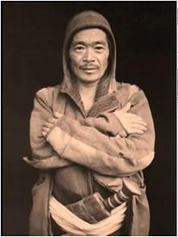
Rule Of Kirat
Kirati Flag
Kirati Tribes men

Slide 6
Rule of Kirat
Altogether 32 Kirata King ruled over Nepal for about 800 years
First king of Kirata was Yalamber and the last one was Gasti
It is believed that Kiratis defeated the Mahispal of the valley and took over power

Slide 7
After Kirat dynasty 5 Soma dynasty kings ruled in the country and they were
Nimish
Mataksha
Kakvarma
Pashupreksha
Vaskarvarma

Slide 8
Rule of Lichhavi’s
Lichhavis ruled from about 100 A.D. to 880 A.D.
First Lichhavi king was Supuspa
They are seen from different clan like Gupta, Verma, Dev and Sen
Brisha Dev, Man Dev, Amsuverma and Narendra Dev were strong and powerful king

Slide 9
As Lichhavi Nepal was vast in size, the territories out side the valley were given to Feudal Lords
Feudal Lords used to present at Royal palace from time to time to give their respect to the King
There were dual rule during Lichhavi period
King was nominal state of the stateand powerful courtier become de facto ruler

Slide 10
When king abdicated throne and their heir to the throne was child, powerful courtier become de facto ruler
Sometimes strong and powerful courtier dethroned the king and made favorite Royal family member King and started dual government
During the reign of Dhrub Dev, Jishu Gupta was de facto ruler
Similarly, Bishnu Gupta was during the reign of Bhimarjundev

Slide 11
Territorial boundaries of Ancient Nepal
It was believed that the size of ancient Nepal was about equal to that of present day Nepal
Assam in the east
Godwal state in the west
Himalaya in the North
Areas of Northern Indian in the South

Slide 12
Medieval Period
Medieval period starts from about 937 B.S. (880 A.D.) to 1826 B.S. (1769 A.D.)
Pre-medieval period (937 to 1250) is dark part of history of Nepal because no records or inscription has founnd of this period
In this period the center became weak and Samantas (Feudal lords) became free
In about 12th century 3 powers arose in Nepal
Khas state in the West
Tirhut (Doya) state in tarai or south
Nepalmandal (valley) in middle

Slide 13
Nepalmandal or Malla state
The state was extended
Koshi in the East
Trisuli in the West
Mahabharat range in south
Himalayan region in North
Yaksha Malla (grandson of Jayasthiti Malla) ascended the thrown in 1465 B.S.
He ruled for about 53 year died in 1528
In valley after Yaksha Malla there arose 3 states Kantipur,Patan and Bhaktapur

Slide 14
Yaksha Malla
Kantipur
Patan
Bhaktapur
Ratna Malla
Surya Malla
Ranendra Malla
Mahendra Malla
Shiva singh Malla
Laxminarasingh Malla
Pratap Malla
Bhaskar Malla
Jayprakash Malla
Siddhinarasingh Malla
Shrinicoas Malla
Yogandra Malla
Tejnarasingh Malla
Raya Malla
Pran Malla
Bishwo Malla
Jag Jyoti Malla
Jitamitra Malla
Bhupatindra Malla
Ranajit Malla

Slide 15
Khas State (1150 B.S.)
Nagraj established it
Sinja was the capital of it
Its territory were
Gorkha in the East
Kumaun in the West
Tarai in South
Tibet in North
Krachalla and Jitari Mallawas strong and powerful king
Khas state existed for about 300 years (upto 1450)
In 1450 B.S. this states divided in petty states called Baise and Chaubise Rajyas

Slide 16
Baise Rajya
22 states in Karnali region were called Baise Rajya
Jumla | Bajhang
Chham | Musikot
Acham | Galkot
Thalara | Jajarkot
Rukum | Salyam
Jahari | Chhilli
Rolpa | Gotam
Dang | Majal
Dami | Duloo
Dailekh | Doti
Darma | Bajura

Slide 17
Chaubise Rajya
Pyuthan | Parvat
Gulmi | Argha
Khanchi | Ishma
Palpa | Tanahu
Nuwakot | Kaski
Lamjung | Gorkha
Mustang | Dhurkot
Satahu | Garahum
Paiyum | Bhirkot
Nagarkot | Dhor
Musikot | Rishing
Ghising | Tarki
In Gandaki region there were 24 states called Chaubise Rajya

Slide 18
The number of states were not fixed and their number often fluctuates
Sometimes 2 states unite to form single states and sometimes one states got divided and form many states
They had no good relation among and between states
Among Chaubise Rajya Palpa was strong and vast
Sen dynasty King Ratna Sen and Mukunda Sen was strong and powerful

Slide 19
Sen Kingdom of the East
Besides Baise and Chaubise Rajya there were 3 states in East which were ruled by Sen dynasty king
Makawanpur
Chaudandi
Vijaypur
Mukunda Sen was strong and powerful king in Makawanpur state
Chaudandi state was founded by Jagat Sen
The last King was Karan Sen
Vijaypur was founded by Vijayanarayan Singh and last King was Raghunath

Slide 20
Tirhut or Doya state (1154-1381)
Nanya Dev established this state
It was situated at south of Kathmandu valley
It’s capital was simmraungadh
It remained about 227 years
Harisimha Dev was the last King when Sultan (emperor) of delhi Gaya Suddin Tuglag attacked it in 1381.
Tirhut state dismissed

Slide 21
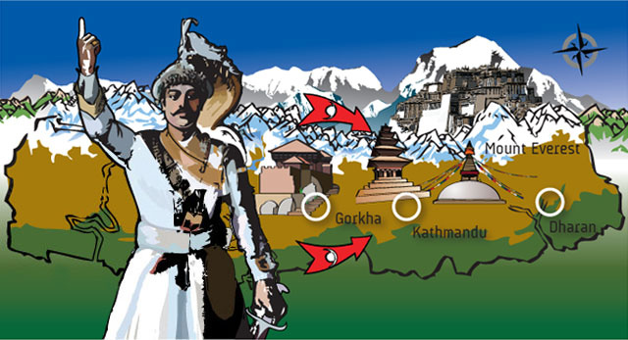
Shah Period
Unification
In 1801 B.S. Prthivi Narayan Shah conquere Nuwakot
In 1819 B.S. Gorkhali troops attaked Makawanpur and got victory
In this war Digbandan Sen , the brother in- laws, fled to Hariharpur Gandhi
Later on the troops also claimed this place and put Digbandhan Sen under detention in Gorkha

Slide 22
Gorkha troops attacked Kirtipur in 1821 B.S.
At last gorkhalis surrounded the Kritipur from all sides for 3 months
Kaji Dhanawanta surrendered to gorkhali troops
Kirtipur annexed to Gorkha

Slide 23
Prithivinarayan Sha got victory over 3 states of the valley
He attacked Kantipur in 1824 B.S.
Prithivinarayan Shah encountered with the armies of East India Company
The attack was done in the day of Indrajatra

Slide 24
Patan was annexed in the same year without any bloodshed
Six Pradhan surrendered to Gorkhali troops
Jay PrakashNarayan and Tez Narasingh Malla fled to Bhaktapur
Prithivinarayan Shah annexed Bhaktapur to greater Nepal after Raj Ranjit Malla surrendered with him

Slide 25
After conquered the valley, Prithivinarayan Shah more towards two East Sen states – Chauandi and Bijaypur
In 1830 B.S. the Nepalese troops conquered over Chaudandi
In 1831 Shrawan Nepali troops attacked Vijaypur and got victory
Buddhi Karna Rai (minister) and Karna Sen (King) fled to Sikkim
The King of Sikkim was requested to return them to Nepal
Instead the King of Sikkim returned Ilam to Nepal which had earlier been captured from Vijaypur

Slide 26
King Prithivi Narayan Shah died at Devghat in Magh 1, 1831 at the age of 52

Slide 27
Unification Campaign Of Prithivi Narayan Shaha
1801 B.S. Nuwakot
1819 B.S. Makawanpur
1821 B.S. Kirtipur
1824 B.S. Three states of valley
1830 B.S. Chaudandi
1831 B.S. Vijaypur
Kantipur
Patan
Bhaktapur

Slide 28
Rajendra Laxmi
After the death of Pratap Singh Shah his two and half year old son Rana Bahadur Shah became the King of Nepal
Rana Bahadur Shah being the child his mother Rajendra Laxmi gave continuity to Unification campaign of his father-in-laws (Sasura)
She sent troops to Chaubise Rajyas and annexed to the Greater Nepal

Slide 29
Different states Rajendra Laxmi annexed to greater Nepal under her leadership are:
Tanahun | Rising
Sirhanchok | Kaski
Parbat | Paiyun
Lamjung | Bhirkot
Pallo Nuwakot | Satahun
She died in 1842 B.S.

Slide 30
Bahadur Shah (1815-1855 B.S.)
He is the second son of Prithivi Narayan Shah
He ruled in Nepal as a regent of vhild King Rana Bahadur Shah
He gave continuity to the unification campaign
In 1843 he annexed all the Chaubise states to Greater Nepal
He conquered Gulmi, Argha, Khanchi, Parbat, Pyuthan, Dang, Rasunga, Salyanthokand Rolpa

Slide 31
Gulmi , Arghakanchi were given to Palpa according to treaty
Bahaddur Shaha also got victory over Dailekh, Achham, Jumla and Doti (Baise states)
In 1848 B.S. he reached upto Garhawal
He made a treaty with Garhawal and Garhawal would pay Rs 9000 per annum
Nepal signed a treaty with China at Thapathali in 1849 B.S.

Slide 32
BHIM SEN THAPA (1832- 1896 B.S.
He got Kazi post in 1861 B.S. and got mukhtiyari after the death of Rana Bahadur Shah
In this time Nepal’s territory reached upto Tista in East and Sutlej in West
He was strongly against East- India company
Anglo – Nepal broke out in his time in 1871 B.S.
A great unequal and harassment Sugauli treaty was made
The treaty shrinked Nepal’s territory Mechi in East to Mahakali in the West
It stopped the unification campaign of Nepal forever

Slide 33
TO BE CONTINUED…

