Slide 1
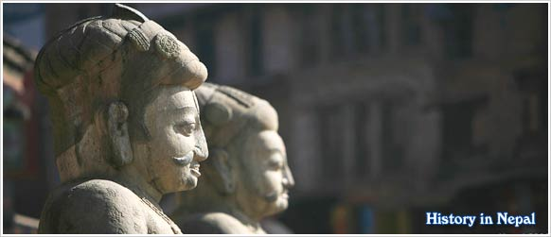
POLITICAL HISTORY OF NEPAL - II
Prof Dr Devi Bdr Thapa

Slide 2
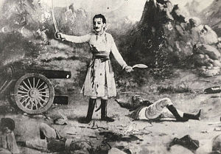
ANGLO – NEPAL WAR
In 1814 A.D. there was made war between Nepal and British India Company government

Slide 3
Cause of war
Company government created disputes over Butwal and Syuraj
Formarily these states were under the King of Palpa who used to pay land tax to the King of Awadha
The East India Company claimed these states
English Governor general sent a letter of intimidation to Nepal immediately to vacant Butwal and Syuraj
Nepal decided not to leave these states
Thus in 1871 B.S. Governor General Lord Hasting declared war against Nepal

Slide 4
WAR EVENTS
War of Nalapani
War of Deuthal and Bhakti Thapa
War of Western Side and Amar Singh Thapa
Sugauli Treaty

Slide 5

War Of Nalapani

Slide 6
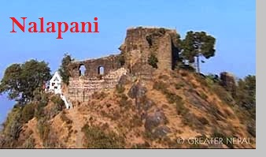
War of Nalapani
Nepali troops under the leadership of commander-in-chief Bal Bhadra Kunwar fought bravely against English troops
In this war English Major General Gillespie and Liuetenant Ellis were killed by Nepali troops in Khalanga fort
English troops cut off water supply to fort of Khalanga
Nepali troops including women , children and old men fought there upto their last breathe
Nepali women showed their extra-ordinary talency in the war

Slide 8
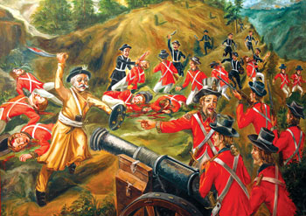
War of Deuthali and Bhakti Thapa
Deuthal was seized by English troops so most of western side of Nepal became unsecure
Bhakti Thapa went Deuthal to return it with 2000 army
Bhakti Thapa fought very bravery in this war
Suddenly a cannon bullet seared his chest and he attained martyrdom

Slide 9
War of western side and Amar Singh Thapa
Amar Singh Thapa was sent to western Nepal to fight against company troops
He fought bravery but he had not adequate weapons and sufficient army personnel
He had only 250 armies so last he surrendered to Ochterlony

Slide 10
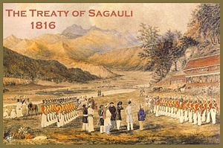

Slide 11
SUGAULI TREATY
This treaty was made between Nepal and East India Company in 1816 A.D.
This treaty was signed by Nepal after the defeat in war with East India Company
This treaty fixed the Nepal border from Mechi to Mahakali river
Nepal lost 1/3rd of its territory

Slide 12
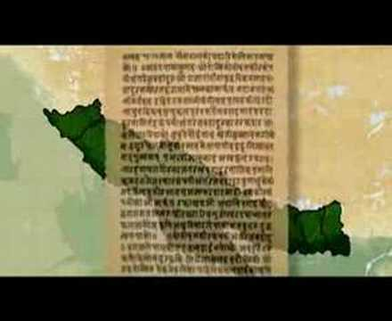
Conditions of sugauli treaty are as follows
Nepal has to leave places behind Mechi and Mahakali including plain area of terai
East India Company would give two hundred thousand per year to Nepal as tax of terai region
British government would open embassy in Kathmandu
Nepal would not recruit Nepali youths other than British and India without the consent of East India Company

Slide 13
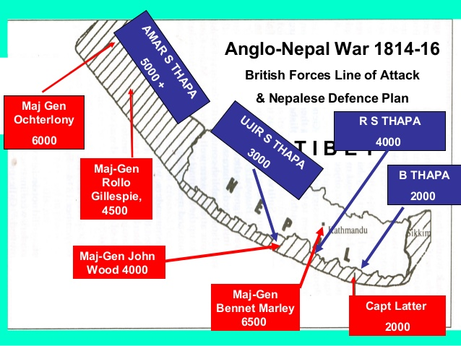

Slide 14
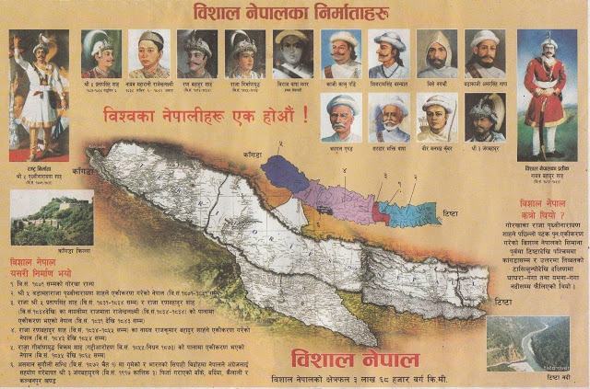

Slide 15
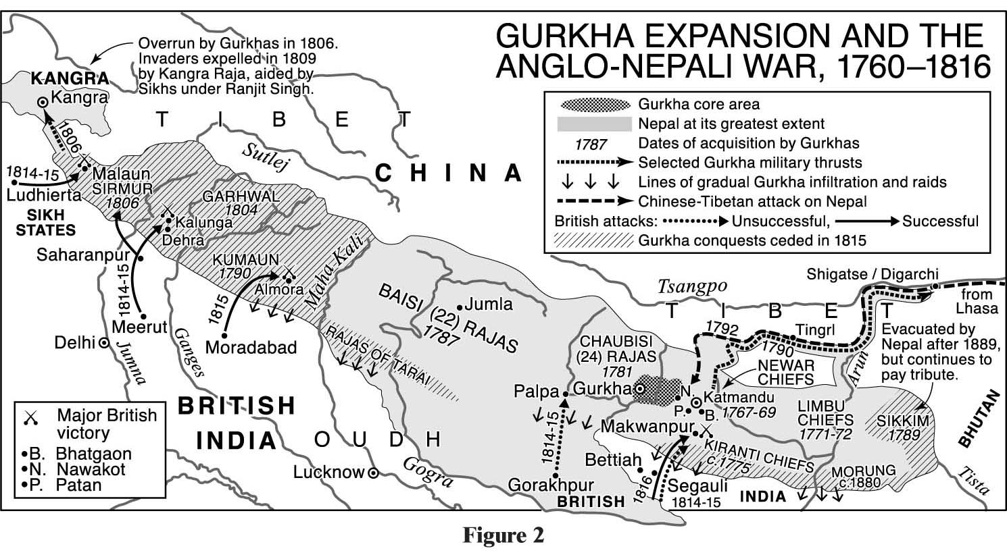

Slide 16
THE RANAS

Slide 17

Rana Period (1902-2007
Rana ruled over Nepal for about 104 years
Rana government was autocratic
Nepali people were not given any sort of rights by Ranas
They spent wealth of the nation for their luxurious life

Slide 18
Anti Rana movement
Rana government was dispotic and not given political rights to the people
Nepali people were exploited and supressed by the Rana ruler
Economic condition of Nepal was miserable
Society was divided in have and have not
In such conditios, it was natural for nepali people to protest Rana regime

Slide 19
Efforts of Nepali people against Rana
Prachand Gorkha ( 1988 B.S.)
It was secret association against Rana government. It was formed by Khadgaman Basnet, Khadga Man Singh, Ranga Nath Sharma, Man Bahadur Khatri. The aim of this organization was to finish Rana from violent way. The plan was to finish all Rana who were in power including Juddha Shamsher. When this secrecy came to know to Juddha all members of this organization were caught and punished.

Slide 20
Library Episode
During the period of Bhim Shamsher, 46 educated persons including poet Laxmi Prasad Devkota established the Library. The main aim was to educate people. Ram Chandra Adhikari conveyed the message to Prime Minister negatively. All the members were caught and fined Rs 135 per persons.

Slide 21
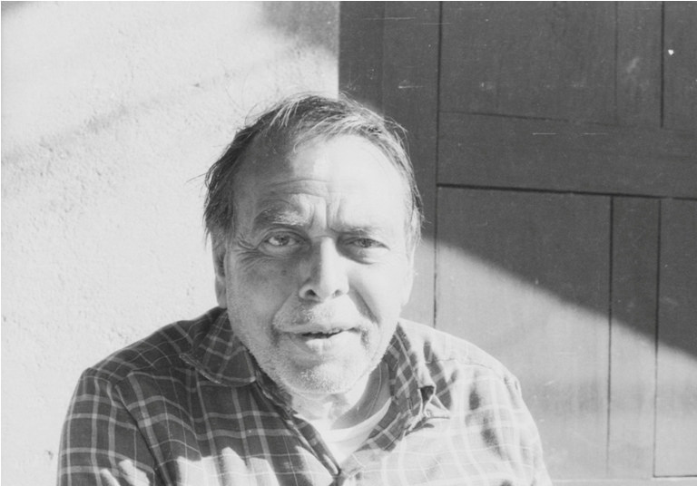
Praja Parisad (1993 B.S.)
The first political party in Nepal
Tanka Prasad Acharya, Ram Hari Sharma, Daasrath Chand, Dharma Bhakta Mathema, Jibraj Sharma were the main persons
The main aim of the party was to establish democracy in the country
It distributed pamphlets and leaflets in Kathmandu
By seeing this type of activities Rana government publish a notice in Gorkhapatra announcing a Rs 5000 prize to the person who disclosed about the party

Slide 22
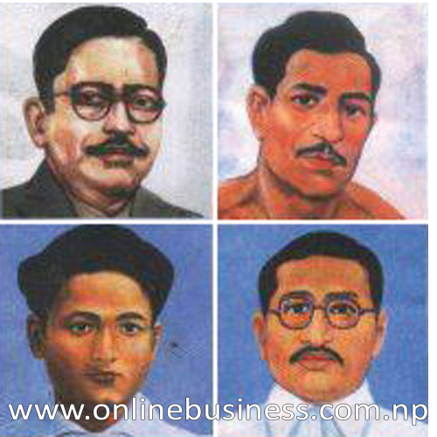
More than 500 party activists were caught
Sukra Raj Sastri , Dashrath Chhand , Dharma Bhakta Mathema and Gangalal Shrestha got Martyrdom in 1997 B.S.
Ram Hari Sharma , Tanka Prasad Acharya were put lifelong in jail

Slide 23


Slide 24

Nepali Congress 2006 B.S.
Nepali people formed a political party in Calcutta in 2003 named Akhil Bharatiya Nepali Rastriya Congress
Chairperson of this party was Tanka Prasad Acharya and acting chairperson was B.P. Koirala
Other members were Bal Chandra Sharma, Dilli Raman Regmi, Krishna Prasad Bhattarai, Ganesh Man Singh
In 27 Chaitra 2006 B.S. Nepali Rastriya Congress and Nepali Prajatantra Congress merged and Nepali Congress formed

Slide 25
Revolution of 2007 B.S.

Slide 26
Factor responsible to the Revolution of 2007 B.S.
Economic Condition
Social Factor
Political Factor
International Factor

Slide 27
Economic Condition
During Rana period economic development was not made
Agriculture was traditional
Industries were not established
Nepali people were poor,uneducated
Rana spent wealth of nation as their own personnel property
Nepali people were in miserable condition

Slide 28
Social Factor
Nepali society wasdivided into different social caste and creed
There was no social security
The sisters and daughters were sexually harassed by Ranas
Women were exploited in every field
Child marriage, polygamy, unequal marriage was prevalent
The social siituation of the then society played an important role for the revolution

Slide 29
Political Factor
People had no right
They could not raise any voice against Rana government
People had no right to open association
Only prime minister speak that was law
Prime minister voice was the last decisionfor the punishment and even for the death
To get political right people had to throw oligarchy government

Slide 30
International Factor
Rana government existed with the support of the East India Company
Rana government became helpless when East India Company fled from India in 1948
Nepali leader took part in Indian war of independence and got knowledge about the revolution and freedom of the people
It helped the movement of Nepal
Finally Rana had to accept the defeat and surrender power to the people
The tri-party agreement was made in India to introduce democracy and stop revolution

Slide 31
Political Situation from 2007 to 2017 B.S.
The king, Nepali Congress and Rana agreed to make a democratic constitution and on the basis of the constitution a general election was to be held
For that purpose a joint cabinet was made under the leadership of Mohan Shamsher. In this cabinet Nepali congress also participated. But the cabinet could not last because of dispute between Nepali congress and Rana Prime Minister

Slide 32
After that cabinet was formed in Shrawan 2009 B.S. under the leadership of Matrika Prasad Koirala. He resigned from the post in Asad 2010 B.S.
After the resignation an Advisory government worked upto Ashad 2010 B.S.
Again Matrika Prasad Koirala became prime minister. He resigned on 1st Baisakh 2011

Slide 33
King Tribhuwan went to Switzerland for treatment in 2011
The then Prince Mahendra directly ruled for one year
Tanka Prasad Acharya become Prime Minister in 2013 B.S.
Due to political instability this government also resigned

Slide 34
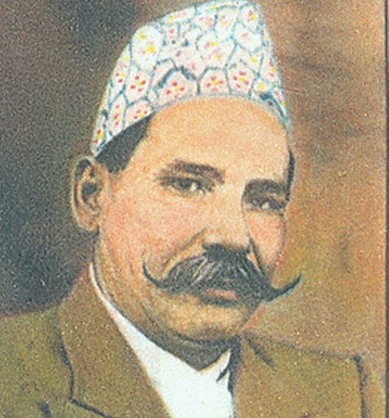
Dr K. I. Singh became prime minister for 110 days in Shrawan 2014
In this time nepali congress started disobedient movement
Constitution draft committee was formed and the date of general election was declared
The constitution was introduced on the 1st of Falgun 2015
General election was held on 17th Falgun 2015

Slide 35
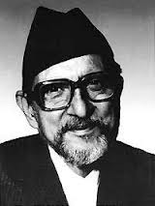
Formation of Nepali Congress Government
In the general election Nepali congress secured more than two third majority in 109 member House of Representative.
It got 74 seat
B.P. Koirala became the first elected Prime Minister of Nepal in 2016 B.S.

Slide 36
TO BE CONTINUED…

